Slide 1
Database Users
Users may be divided into
  Those who actually use and control the database content, and those who design, develop and maintain database applications (called “Actors on the Scene”), and
  Those who design and develop the DBMS software and related tools, and the computer systems operators (called “Workers Behind the Scene”).
Slide 1- <number>

Slide 2
Database Users
Actors on the scene
  Database Designers:
    Responsible to define the content, the structure, the constraints, and functions or transactions against the database. They must communicate with the end-users and understand their needs.
  Database administrators:
    Responsible for authorizing access to the database, for coordinating and monitoring its use, acquiring software and hardware resources, controlling its use and monitoring efficiency of operations.
Slide 1- <number>

Slide 3
Categories of End-users
Actors on the scene (continued)
  End-users: They use the data for queries, reports and some of them update the database content. End-users can be categorized into:
    Casual: access database occasionally when needed
    Naïve or Parametric: they make up a large section of the end-user population.
      They use previously well-defined functions against the database.
      Examples are bank-tellers or university secretaries who do this activity for an entire shift of operations.
Slide 1- <number>

Slide 4
Categories of End-users (continued)
    Sophisticated:
      These include business analysts, scientists, engineers, others thoroughly familiar with the system capabilities.
      Many use tools in the form of software packages that work closely with the stored database.
    Stand-alone:
      Mostly maintain personal databases using ready-to-use packaged applications.
      An example is a scientists that creates a database for its own experiments.
      Another example is a user that maintains an address book
    You may become sophisticated or stand-alone users
Slide 1- <number>

Slide 5
The Database System Environment
Types of software components that constitute a DBMS and the types of computer system software with which the DBMS interacts.
Slide 2-<number>

Slide 6
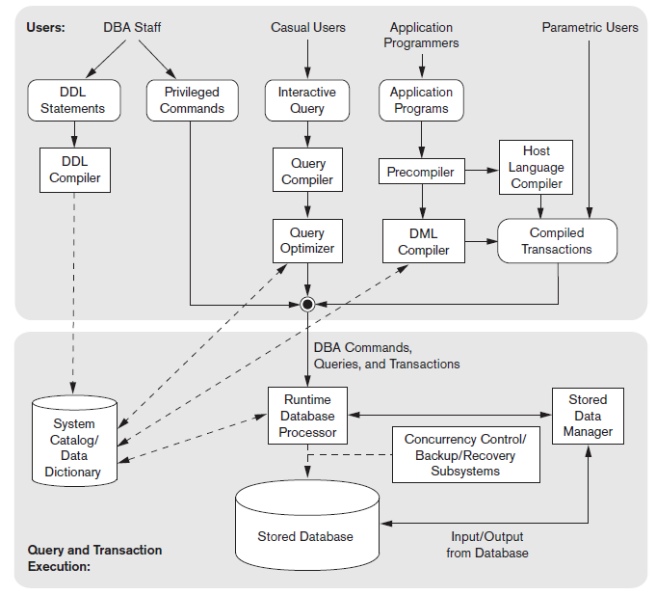
Slide 2-<number>

Slide 7
Centralized and Client-Server Architectures
Centralized DBMS: combines everything into single system including- DBMS software, hardware, application programs and user interface processing software.
Slide 2-<number>

Slide 8
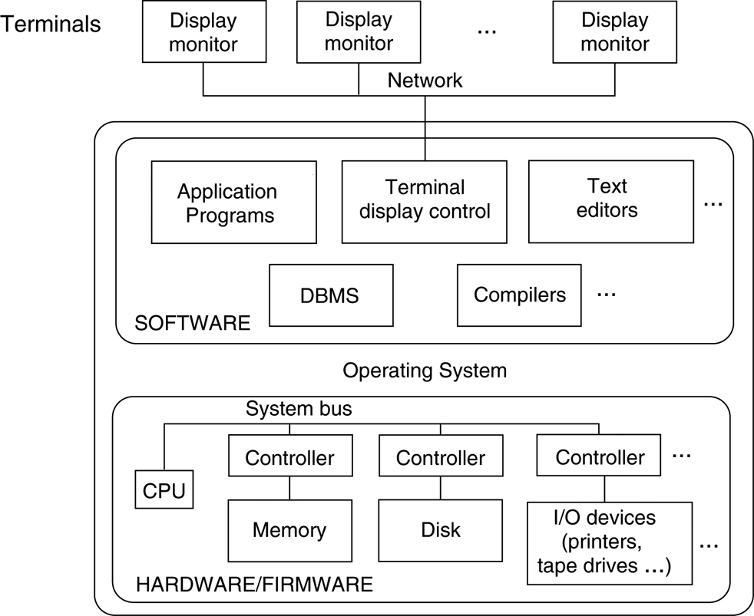
FIGURE 2.4
A physical centralized architecture.
Slide 2-<number>

Slide 9
Specialized Servers with Specialized functions:
File Servers
Printer Servers
Web Servers
E-mail Servers
Slide 2-<number>

Slide 10
Clients:
Provide appropriate interfaces and a client-version of the system to access and utilize the server resources.
Clients maybe diskless machines or PCs or Workstations with disks with only the client software installed.
Connected to the servers via some form of a network.
(LAN: local area network, wireless network, etc.)
Slide 2-<number>

Slide 11
Two Tier Client-Server Architecture
User Interface Programs and Application Programs run on the client side
Interface called ODBC (Open Database Connectivity ) provides an Application program interface (API) allow client side programs to call the DBMS. Most DBMS vendors provide ODBC drivers.
Slide 2-<number>

Slide 12
Two Tier Client-Server Architecture
A client program may connect to several DBMSs.
Other variations of clients are possible: e.g., in some DBMSs, more functionality is transferred to clients including data dictionary functions, optimization and recovery across multiple servers, etc. In such situations the server may be called the Data Server.
Slide 2-<number>

Slide 13
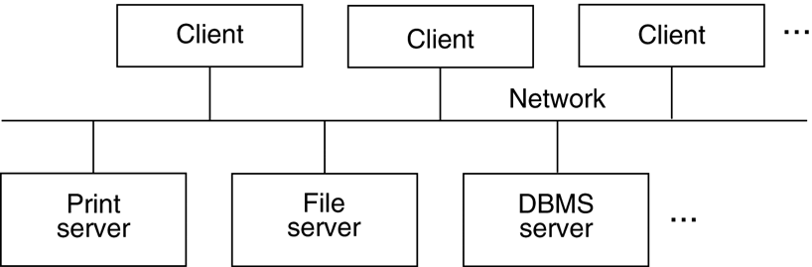
FIGURE 2.5
Logical two-tier client/server architecture.
Slide 2-<number>

Slide 14
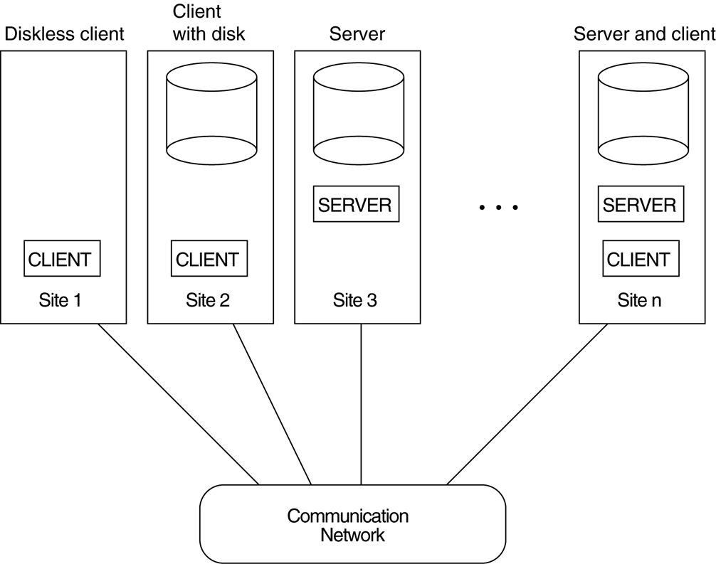
FIGURE 2.6
Physical two-tier client-server architecture.
Slide 2-<number>

Slide 15
The user interface programs and application programs can run on the client side.
When DBMS access is required, the program establishes a connection to the DBMS(which is on the server side); once the connection is created.
the client program can communicate with the DBMS. A standard called Open Database Connectivity(ODBC) provides an application programming interface (API)
A related standard for the Java programming language, called JDBC, has also been defined. This allows Java client programs to access one or more DBMSs through a standard interface
Slide 2-<number>

Slide 16
The architectures described here are called two-tier architectures because the software components are distributed over two systems: client and server.
This architecture are its simplicity and seamless compatibility with existing systems.
Slide 2-<number>

Slide 17
Three Tier Client-Server Architecture
Common for Web applications
Intermediate Layer called Application Server or Web Server:
  stores the web connectivity software and the rules and business logic (constraints) part of the application used to access the right amount of data from the database server
  acts like a conduit for sending partially processed data between the database server and the client.
Additional Features- Security:
  encrypt the data at the server before transmission
  decrypt data at the client
Slide 2-<number>

Slide 18
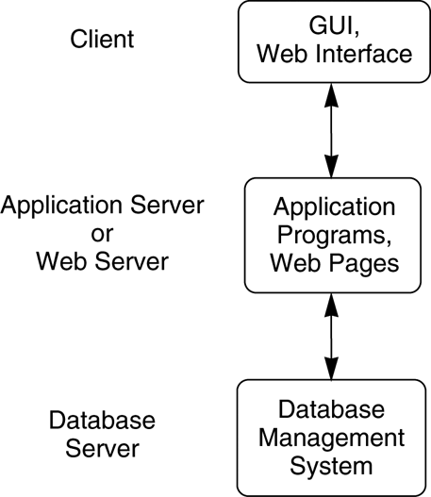
FIGURE 2.7
Logical three-tier client/server architecture.
  (ERP,CRM)
Slide 2-<number>

Slide 19
Classification of DBMSs
Based on the data model used:
  Traditional: Relational, Network, Hierarchical.
  Emerging: Object-oriented, Object-relational.
Other classifications:
  Single-user (typically used with micro- computers) vs. multi-user (most DBMSs).
  Centralized (uses a single computer with one database) vs. distributed (uses multiple computers, multiple databases)
Slide 2-<number>

